Slide 1

Financial News Headlines Analysis Project - Stock Market Fin - LAFIO
July 06, 2022

Slide 2
Fin-LAFIO Team
Domain Experts
IT Experts
Lina Shbaitah
Issa Baitouni
Omar Ja`bari
Ayman Khalaf
Firas Abu Nimreh

Slide 3
Project Goal
To create a platform to help people, who are interested in the stock market, make their investment decision based on the insights they get from our platform (Fin-LAFIO).
To measure the impact of the news headlines (sentiment) on directing the stock market.

Slide 4
Project Persona
Pain
B 2 C
Stage 1
Beginner / New investors
“has only basic knowledge about investments”
“looking for helpful tool & advise”
“ lots of information and sources “
Mid – Experienced Investors
“ looking for trusted one source to summarize information “
B2 C & B2 B
Stage 2
Experienced Investors
“Squeezed Time”
“lots of resources ”
“Looking for deep analysis ”
Businesses/Traders
“Make the decision on behalf of investors”
“Looking for prediction ”

Slide 5
Problem Statement and Value Proposition
It is overwhelming for investors to decide to buy, sell or keep a stock.
Many aspects to consider when deciding.
The stock price is determined by supply and demand,
Stock price are affected positively or negatively by many factors including; news headlines, company value/performance, key people analysis, and gossip in the market.

Slide 6
Fin-LAFIO Idea & Solution
Fin- LAFIO's role will gather all these elements in one place and make the process easier and more insightful for users.
Create a platform to help people, who are interested in the stock market, make their investment decision easier.
Provides Insights extracted, collected and analysed from:
Company performance
News Headlines
Blogs, tweets, influencer Speech, Analysts
Community shares and talks
Gossip in the market

Slide 7
Fin-LAFIO Features
One-Stop-Shop
Easy to Use
Insightsfull
Sentimental Analysis
Prediction
Dashboards

Slide 8
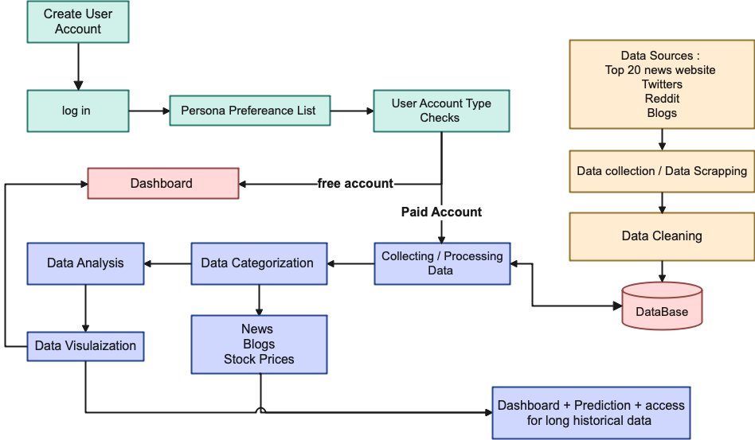
Data Flow

Slide 9
Challenges To Keep Working on
NLP and sentimental Analysis.
Finding the relationship between the stock price and the news and influencer
Describing the headlines as positive or negative and its impact on the price still a challenge and need more improvements.
Gaps between news impacts and reals stock prices.

Slide 10
Web Application Screens

Slide 11
Thank You
Fin – LAFIO Team

